Slide 1

Defense Against the Dark Correlations
Introduction to Causal Reasoning and the PolicyGRID Framework
Taqiya Ehsan
11/04/2025

Slide 2

Correlation vs Causation
Notes:
When Harry Potter casts Rictusempra, Malfoy is thrown backward — not because Harry happens to point his wand each time someone falls, but because the spell itself causes the reaction.
A Muggle observer might notice that “every time Harry raises his wand, Malfoy flies back” and assume a correlation between the gesture and the effect. But Harry understands the mechanism — the incantation, intent, and wand movement jointly cause the spell to work.
Most modern AI systems behave like that Muggle observer: they detect patterns (“wand up → opponent falls”) but lack knowledge of the underlying causal process. True intelligence requires reasoning about why something happens — not just noticing when it does.
“Correlation spots the wand movement. Causation understands the spell.”

Slide 3
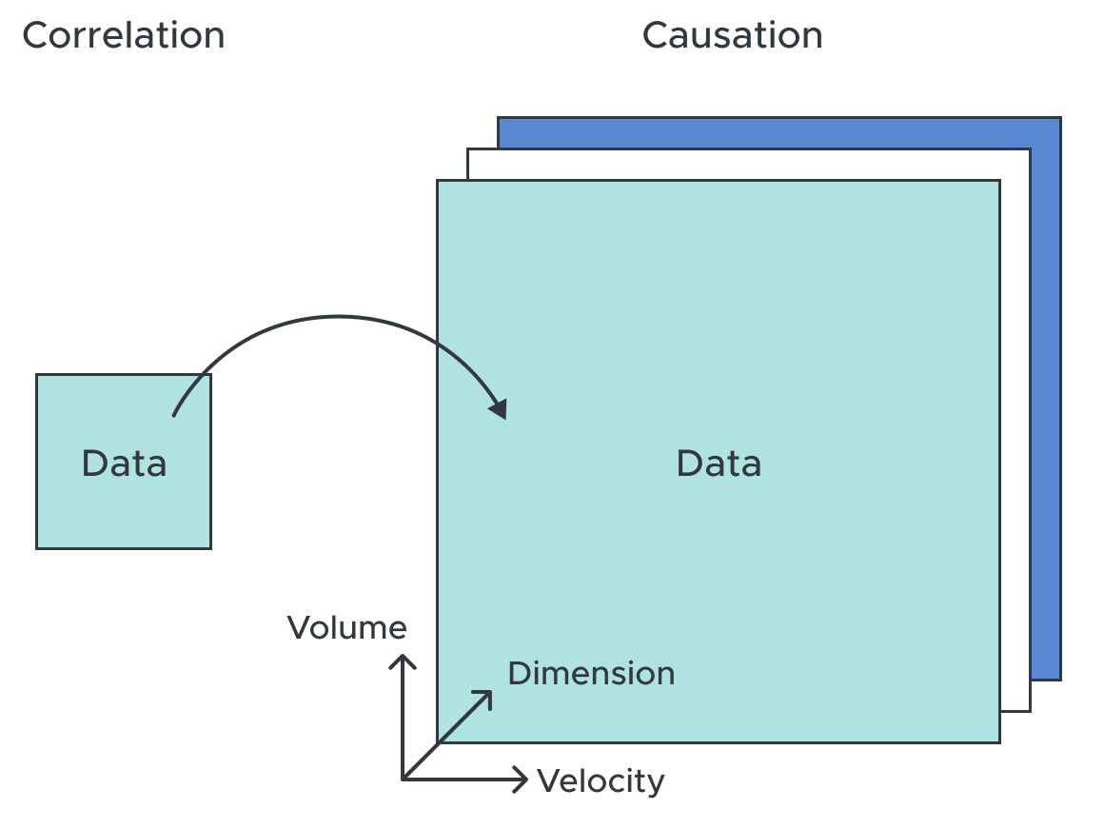
Correlation vs Causation
correlation != causation
models fail when agents intervene
current systems either:
ignore causal structures
treat causality as an offline pre-processing step
Notes:
Embodied agents must reason causally about how their actions affect the environment. Unlike passive observers, agents that act in the world require internal models that predict the consequences of interventions. Correlational models fail when agents intervene because correlation does not imply causation. This fundamental limitation constrains current embodied AI systems to reactive behaviors rather than principled, goal-directed action, despite theoretical work showing that general agents require world models for multi-step generalization. Current approaches to embodied decision-making either ignore causal structure entirely or treat causal discovery as a separate preprocessing step. This disconnect prevents embodied agents from integrating causal reasoning directly into their decision-making processes. Discovering causal structure alone is 33 insufficient; the structure must be leveraged for principled policy generation.
Why is it Important?
Goes beyond correlation to establish causation.
CORRELATION: A statistical measure that describes the size and direction of a relationship between two or more variables. For example, ice cream sales and pool drownings are correlated because both increase during the summer.
CAUSATION: Means that one event causes another event to occur. For example, warmer temperatures in the summer cause both ice cream sales and pool drownings to increase.
Correlation does not automatically mean that one variable causes the other. For example, smoking is correlated with alcoholism, but it does not cause alcoholism.
Enables robust decision-making in complex systems.
Critical for scenarios where interventions have cascading effects.

Slide 4
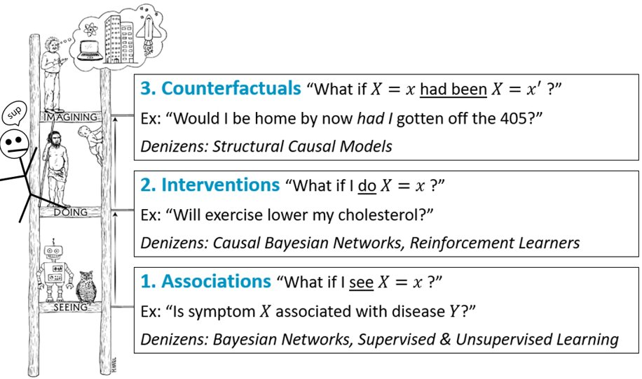
The Causal Ladder
Levels of Reasoning (Pearl, 2019)
Causal reasoning is the ability to uncover cause-and-effect relationships to explain events and predict outcomes.
Pearl, Judea. "Models, reasoning and inference." Cambridge, UK: Cambridge University Press 19.2 (2000): 3. Pearl, Judea, and Dana Mackenzie. ”The book of why: the new science of cause and effect.” Basic books, 2018.
Notes:
What is Causal Reasoning?
Definition: Causal reasoning is the process of identifying cause-and-effect relationships between variables to explain why things happen and predict outcomes.
Key Features:
Directed Relationships: Models how changes in one variable directly affect another.
Counterfactual Analysis: Explores "what if" scenarios to predict alternative outcomes.
Intervention Design: Identifies actions to achieve desired results.
Applications:
Smart Environments: Optimizing energy use and user comfort.
Healthcare: Diagnosing disease mechanisms.
Economics: Evaluating policy impacts.

Slide 5
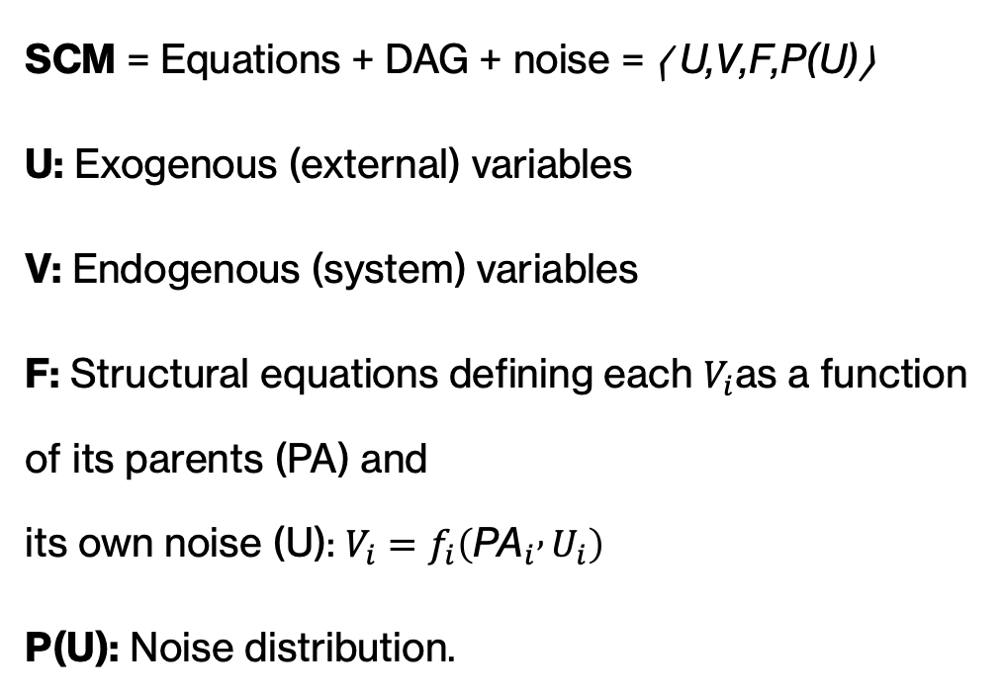
Structural Causal Model (SCM)
formalizes how variables in a system influence one another.
SCM = Equations + DAG + noise = ⟨ U,V,F,P(U)⟩
U: Exogenous (external) variables
V: Endogenous (system) variables
F: Structural equations defining each $V_{i}$as a function of its parents (PA) and its own noise (U): $V_{i}=f_{i}\left({\text{PA}}_{i} , U_{i}\right)$
P(U): Noise distribution.
Notes:
X(1-3) endogenous; X(4-5) exogenous. U (noise terms)
Nodes $X_{1},X_{2},X_{3}$are independent causes (no parents).
$X_{4}$and $X_{5}$are effects determined by those causes plus random noise.
Intervening on a cause (e.g., setting $X_{1}$) changes both $X_{4}$and $X_{5}$.

Slide 6
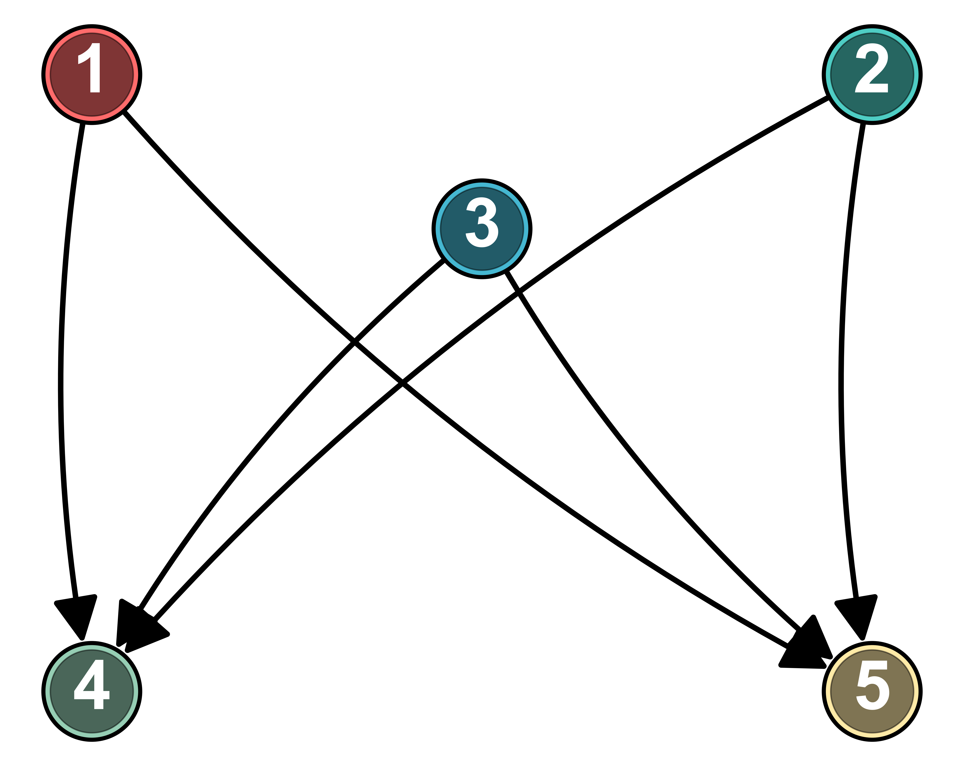
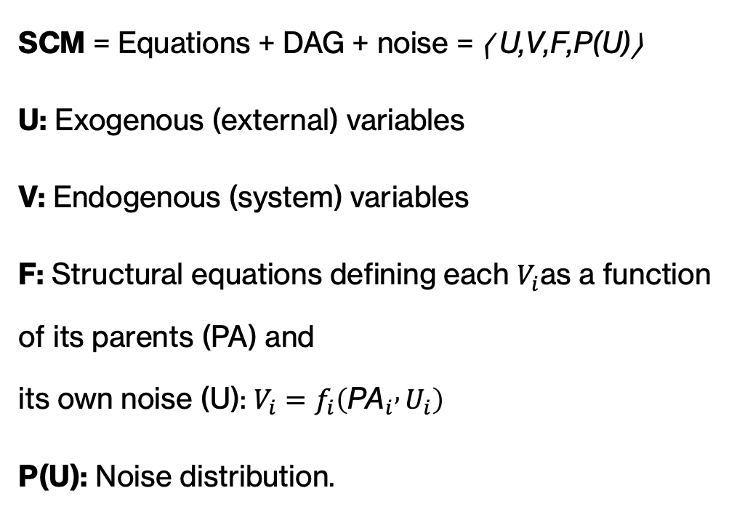
Structural Causal Model (SCM)
formalizes how variables in a system influence one another.
SCM = Equations + DAG + noise = ⟨ U,V,F,P(U)⟩
U: Exogenous (external) variables
V: Endogenous (system) variables
F: Structural equations defining each $V_{i}$as a function of its parents (PA) and its own noise (U): $V_{i}=f_{i}\left({\text{PA}}_{i} , U_{i}\right)$
P(U): Noise distribution.
X₁=U₁​; X₂​=U₂; X₃​=U₃
X₄ =​0.4 X₁ ​+0.3X₂​​+0.3 X₃ ​+ U₄​;
X₅ ​​=0.5 X₁ ​+0.2X₂​​+0.3 X₃ ​+ U₅
Notes:
X(1-3) endogenous; X(4-5) exogenous. U (noise terms)
Nodes $X_{1},X_{2},X_{3}$are independent causes (no parents).
$X_{4}$and $X_{5}$are effects determined by those causes plus random noise.
Intervening on a cause (e.g., setting $X_{1}$) changes both $X_{4}$and $X_{5}$.

Slide 7
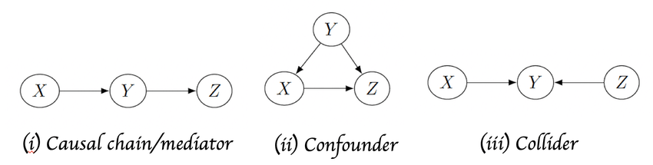
d-Separation: Causal Graphs Intuition When are X and Y independent, given Z?
Z
Z
Y
X
Y
X
Z
Y
X
Notes:
Condition --> Let’s only look at situations where this variable has a known value; holding a variable fixed or using it as known information
Mediator/Chain: A variable Z transmits the effect from X to Y. X and Y are dependent BUT Conditional on Z: X and Y become independent (blocked). Z is mediator
Increasing ventilation lowers humidity, which in turn improves comfort.
Confounder/Fork: A variable Z influences both X and Y. X and Y are dependent BUT Conditional on Z: X and Y become independent (blocked). Z is confounder → creates spurious correlation.
Humidity affects both ventilation rate (how often fans turn on) and occupant comfort — making it seem like ventilation “causes” comfort directly.
Collider (Common Effect): A variable Z is caused by both X and Y — conditioning on Z induces false correlation.
Both ventilation and temperature changes increase energy use. If we condition on energy use, we might incorrectly infer a relationship between ventilation and temperature.
Directionality and conditioning determine whether associations reflect true causation or artifacts.
Conditioning can either block or open paths between variables. Understanding these patterns is the foundation of d-separation — the rule set that defines independence in a causal graph.
X and Y are d-separated by Z if ALL paths blocked.
🧠 Analogy
Think of conditioning like putting on “glasses” that only let you see data from a certain perspective:
Without glasses → you see all data → $P\left(Y\right)$.
With glasses focused on X=1 → you only see the subset → $P\left(Y∣X=1\right)$.
You haven’t changed the world — you’ve just filtered your view of it.

Slide 8
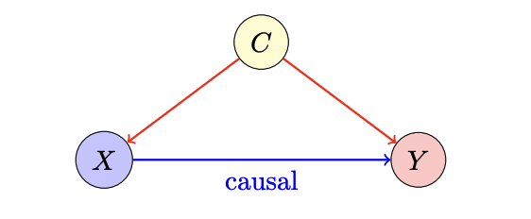
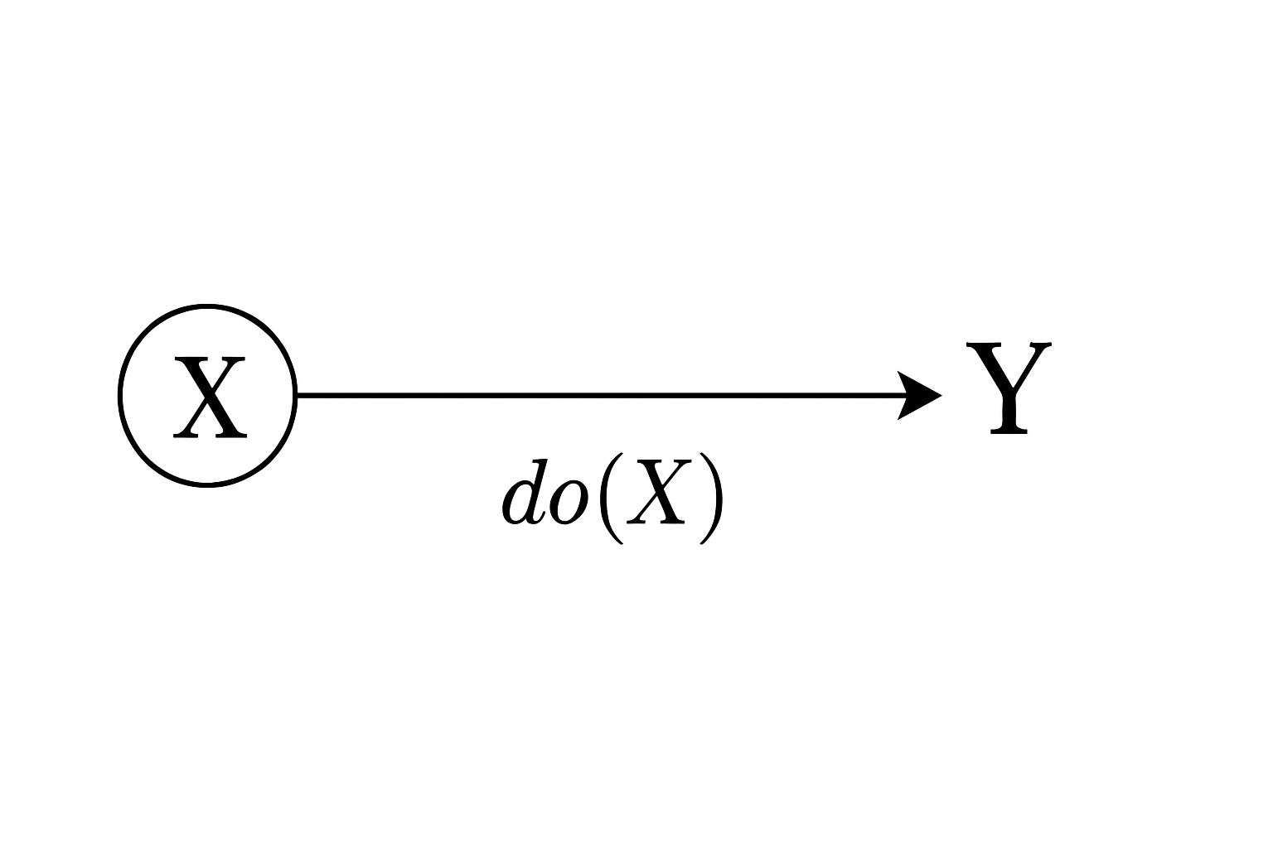
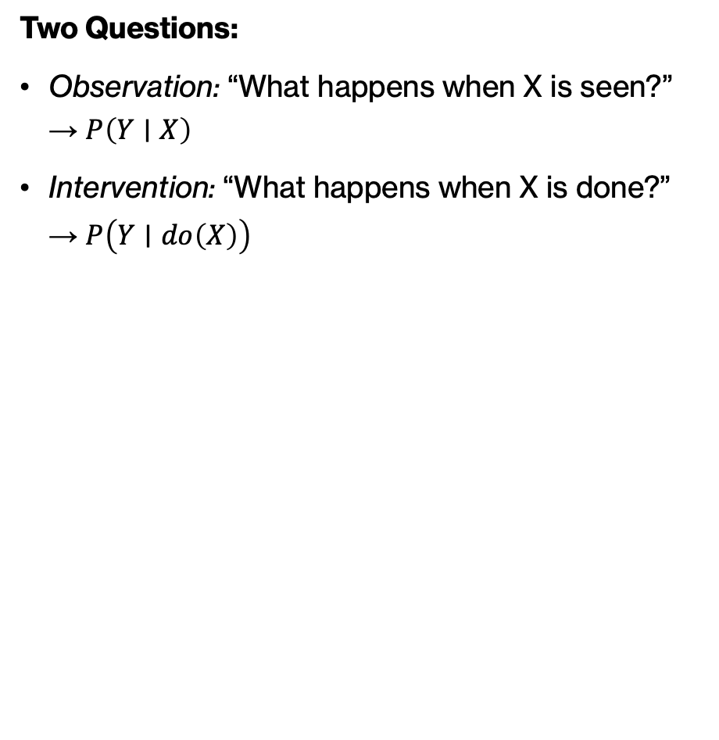
Back Door Criterion: do Operator
Two Questions:
Observation: “What happens when X is seen?” → $P\left(Y∣X\right)$
Intervention: “What happens when X is done?” → $P\left(Y∣do\left(X\right)\right)$
back-door path: X ← C → Y (confounding)
block by conditioning on C → identify causal effect.
Notes:
Even if X and Y are correlated, this doesn’t mean X causes Y — there may be a confounder C that affects both.
In the graph: $C→X$and $C→Y$
This opens a back-door path: $X←C→Y$
“The back-door path — that’s $X←C→Y$— is like a hidden side entrance letting bias leak into our estimate. To get the true causal effect, we need to block that path by conditioning on C.”
To estimate the true causal effect of X on Y, we must block this path by conditioning on C.
Intuition
“Seeing” X only gives observational dependence (possibly confounded).
“Doing” X simulates an experiment — breaks incoming arrows into X and measures the direct causal effect.
Conditioning on all variables that open back-door paths ensures we estimate $P\left(Y∣do\left(X\right)\right)$ correctly.
That’s what the do-operator represents: breaking incoming arrows into X and isolating its direct causal effect on Y.”
🧩 Example: Temperature (C) affects both Ice Cream Sales (X) and Drownings (Y).
$P\left(Y∣X\right)$overestimates the effect (spurious).
$P\left(Y∣do\left(X\right)\right)$removes the temperature effect — the true causal relation is near zero.

Slide 9
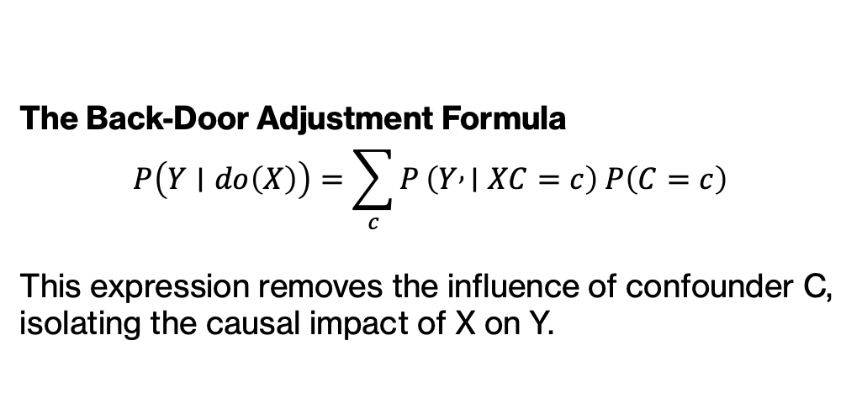
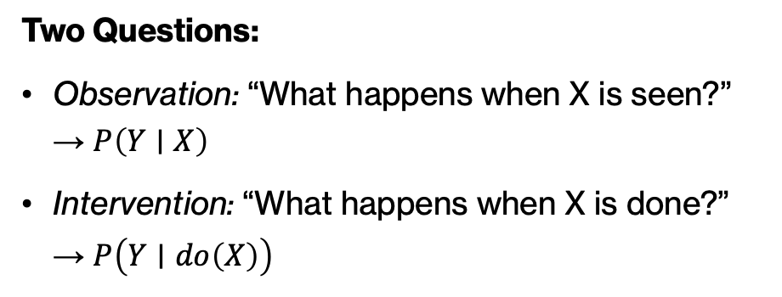
Back Door Criterion: do Operator
Two Questions:
Observation: “What happens when X is seen?” → $P\left(Y∣X\right)$
Intervention: “What happens when X is done?” → $P\left(Y∣do\left(X\right)\right)$
The Back-Door Adjustment Formula
$$P\left(Y∣do\left(X\right)\right)=\sum_{c}{P}\left(Y , ∣XC=c\right) P\left(C=c\right)$$
This expression removes the influence of confounder C, isolating the causal impact of X on Y.
Notes:
Even if X and Y are correlated, this doesn’t mean X causes Y — there may be a confounder C that affects both.
In the graph: $C→X$and $C→Y$
This opens a back-door path: $X←C→Y$
To estimate the true causal effect of X on Y, we must block this path by conditioning on C.
Intuition
“Seeing” X only gives observational dependence (possibly confounded).
“Doing” X simulates an experiment — breaks incoming arrows into X and measures the direct causal effect.
Conditioning on all variables that open back-door paths ensures we estimate $P\left(Y∣do\left(X\right)\right)$correctly.
🧩 Example: Temperature (C) affects both Ice Cream Sales (X) and Drownings (Y).
$P\left(Y∣X\right)$ overestimates the effect (spurious).
$P\left(Y∣do\left(X\right)\right)$ removes the temperature effect — the true causal relation is near zero.

Slide 10
Background
Causal Discovery reveals complex causal relationships in observational data, crucial for scientific and practical applications
Causal Inference quantifies the influence of variables once a causal structure is identified.
Challenges:
Requires substantial domain-specific expertise.
Involves inferring causal graphs from data, a complex task.
Conventional Algorithms:
Utilize statistical techniques, machine learning, and deep learning.
Depend heavily on domain experts.
Face issues like data bias, imbalance, and static data limitations.
LLM-based Approaches:
Exhibit notable reasoning capabilities but struggle with full causal graph construction.
Limited scalability and accuracy in large-scale settings.
Synergistic Approaches combine LLMs with other methods and can enhance understanding of causal mechanisms.
Notes:
Sparse Data: Real-world data is often insufficient to capture true probability distributions accurately.
Static Data: Reliance on static data risks accuracy, especially in dynamic environments.
Edge Orientation: Difficulty in inferring complete edge orientations due to equivalent DAGs.
Expert Dependence: Requires domain experts, who are scarce, costly, and variable in quality.
Language Proficiency: Traditional algorithms lack language understanding, limiting their ability to answer user-submitted causal questions.

Slide 11
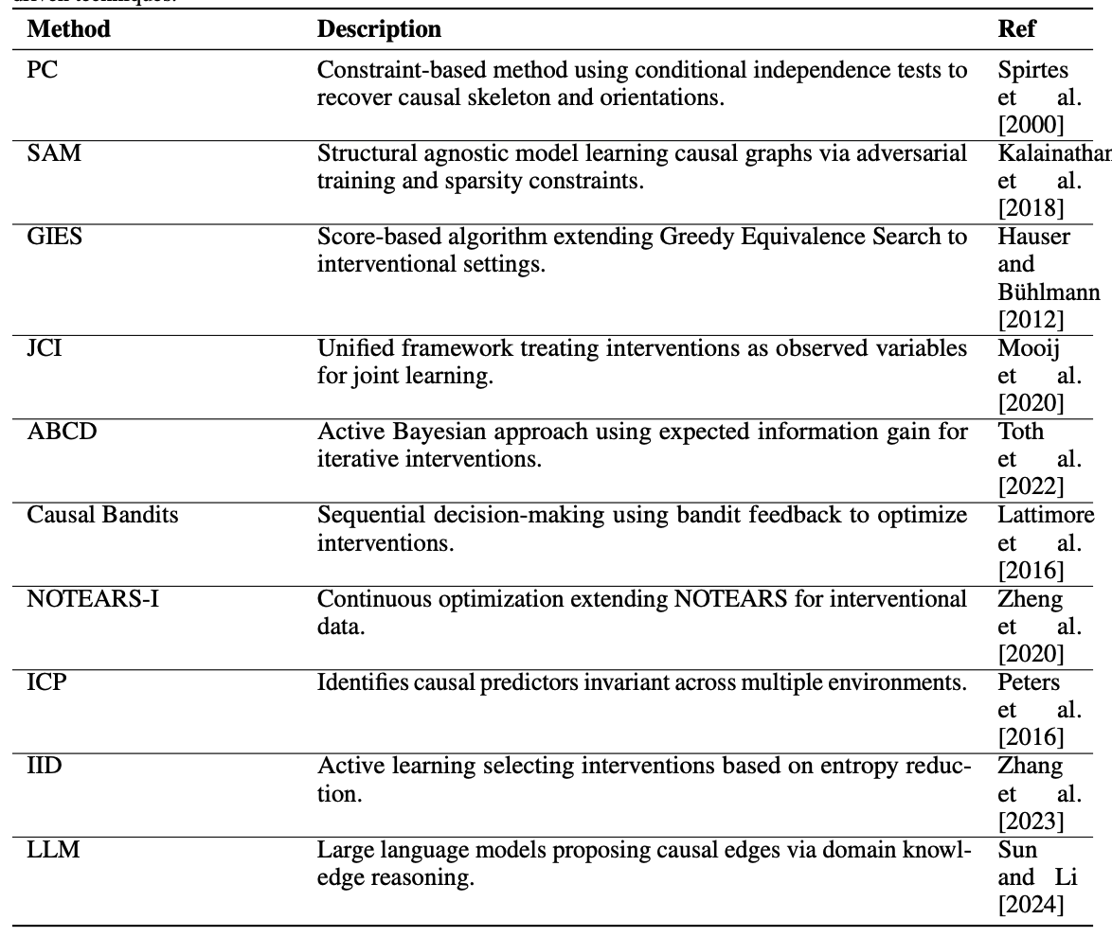
Data-driven Causal Discovery Algorithms

Slide 12
BUT…
Sparse Data: Real-world data is often insufficient to capture true probability distributions accurately.
Static Data: Reliance on static data risks accuracy, especially in dynamic environments.
Edge Orientation: Difficulty in inferring complete edge orientations due to equivalent DAGs.
Expert Dependence: Requires domain experts, who are scarce, costly, and variable in quality.
Interpretability: Traditional algorithms lack interpretability, limiting their ability to answer targeted causal questions.

Slide 13
Conventional Data-driven Causal Discovery (CCD) Algorithms
LLMs for Causal Discovery tasks
Precision: LLMs lack the precision needed for complex, user-generated causal queries.
Nuanced Understanding: Limited in dissecting and comprehending nuanced causal concepts without additional algorithms.
Causal Graph Construction: Struggle to construct complete causal graphs due to oversimplified understanding.
Large Datasets: Difficulty handling extensive datasets, missing depth and variability.
Sparse Data: Real-world data is often insufficient to capture true probability distributions accurately.
Static Data: Reliance on static data risks accuracy, especially in dynamic environments.
Edge Orientation: Difficulty in inferring complete edge orientations due to equivalent DAGs.
Expert Dependence: Requires domain experts, who are scarce, costly, and variable in quality.
Language Proficiency: Traditional algorithms lack language understanding, limiting their ability to answer user-submitted causal questions.

Slide 14

Why Causality Matters
Prediction ≠ Understanding
Correlations describe what tends to happen
But actions change the world — correlations break under intervention
Real-world systems need stability, transferability, and control
Goal: move from seeing patterns → understanding mechanisms

Slide 15
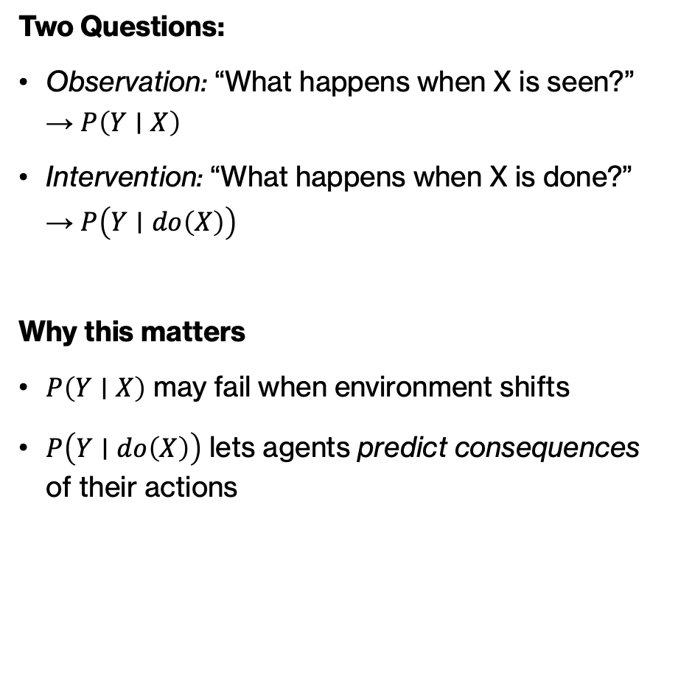
From Observation to Intervention
Two Questions:
Observation: “What happens when X is seen?” → $P\left(Y∣X\right)$
Intervention: “What happens when X is done?” → $P\left(Y∣do\left(X\right)\right)$
Why this matters
$P\left(Y∣X\right)$ may fail when environment shifts
$P\left(Y∣do\left(X\right)\right)$ lets agents predict consequences of their actions

Slide 16

PolicyGRID: Acting to Understand, Understanding to Act
NeurIPS 2025 Workshop on Embodied World Models for Decision Making

Slide 17
The Causal Ladder
Levels of Reasoning (Pearl, 2019)
PolicyGRID operates at 2–3
- Learns how actions change outcomes
- Uses causal understanding to design better control policies
Notes:
Levels of Reasoning (Pearl, 2019)
Association: Seeing — $P\left(Y∣X\right)$
Intervention: Doing — $P\left(Y∣do\left(X\right)\right)$
Counterfactual: Imagining — “What if X had been different?”
PolicyGRID operates at Level 2–3
Learns how actions change outcomes
Uses causal understanding to design better control policies

Slide 18
Why PolicyGRID
Bridging Understanding and Action
Existing agents → ignore causality or treat it as offline pre-processing
PolicyGRID: → discovers causal structure → validates interventions → translates causal knowledge into adaptive policies
Acting to Understand, Understanding to Act

Slide 19
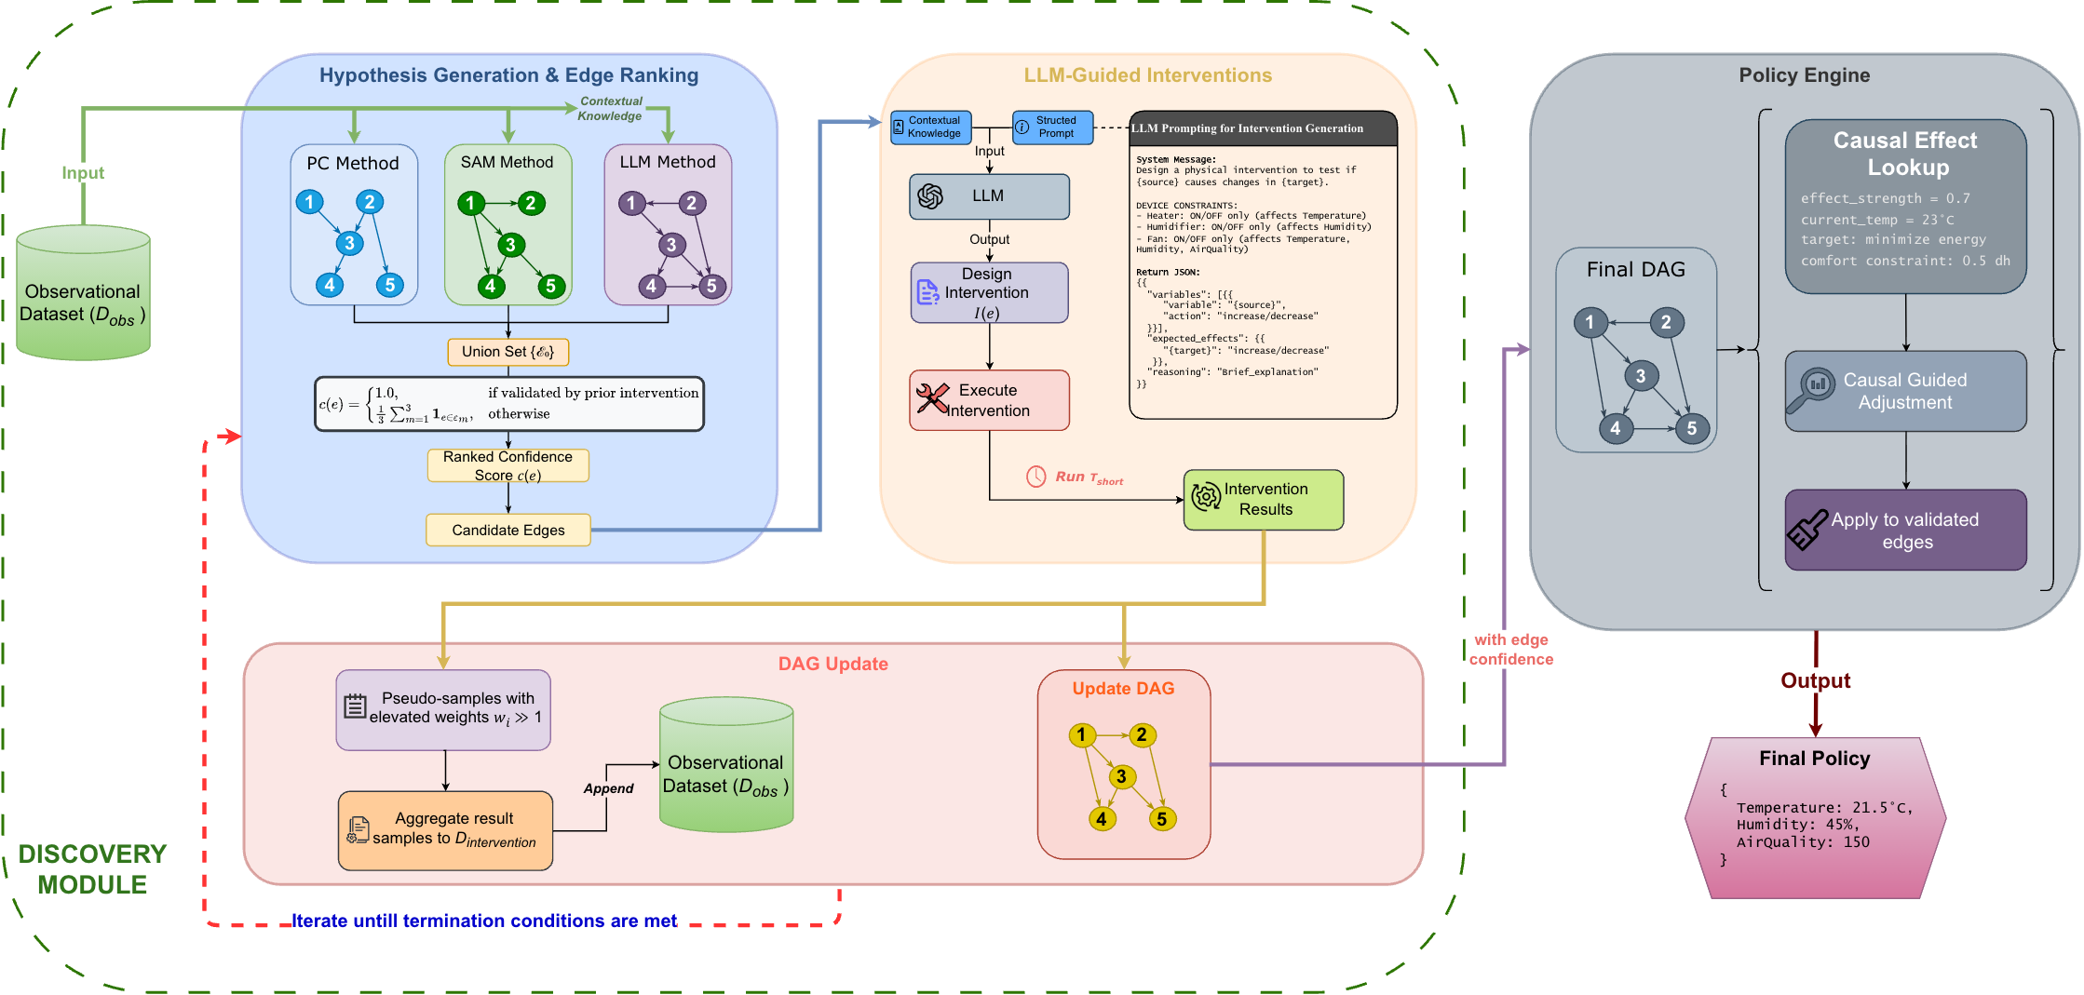
PolicyGRID
Discovering causal structure from data
Validating causal relationships
Translating causal knowledge into policies.
Notes:
The framework addresses three key requirements for embodied causal reasoning: (1) discovering causal structure from observational and interventional data, (2) validating causal relationships through 44 targeted experiments, and (3) translating causal knowledge into operational policies. By integrating these components, POLICYGRID enables agents to reason about the consequences of their actions rather than merely react to correlations. This work extends the embodied world model discourse by demonstrating how causal reasoning can be embedded directly within the policy loop, moving beyond the latent dynamics models of Hafner et al. [2020] and the meta-learning approaches of Finn et al. [2017] toward principled interventional reasoning [Battaglia et al., 2016, Wu et al., 2015].
Contributions. We establish three insights for embodied causal reasoning. First, interventions serve dual purposes: control actions simultaneously manipulate the environment and refine the agent’s causal understanding. POLICYGRID treats each action as both a policy decision and an experiment that updates internal world models. Second, causal discovery need not precede control but can occur within it. Agents probe their environment to resolve structural uncertainty while optimizing for objectives, collapsing the traditional separation between learning and acting. Third, policies grounded in validated causal structure outperform correlation-based alternatives in multi-objective settings. Empirical validation demonstrates F1 = 0.89 for causal recovery and 2.8× hypervolume improvement over correlation-based methods, confirming that causal world models provide a more reliable foundation for multi-objective control than statistical dependencies alone.

Slide 20
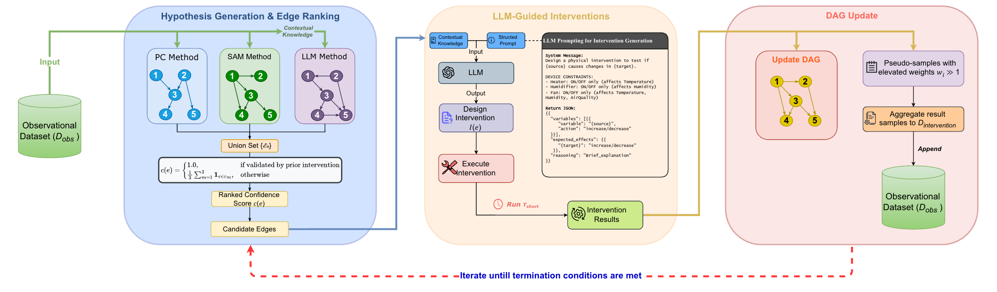
Discovery Module

Slide 21
Discovery Module: Hypothesis Generation
3 generators: PC, SAM, LLM
Hypothesis edge union + scored ranking
Start iterative testing in ascending order of confidence scores

Slide 22
Discovery Module: Interventions
Intervention on each edge
LLM designs the intervention to be executed
Notes:
the effect_size ratio has:
Lower bound: 0 (when source_change ≤ 0.001 or target doesn't change)
Upper bound: Unbounded theoretically, but confidence calculation caps at 1.0 via confidence = min(1.0, avg_effect * consistency_factor)
Practical range: Typically 0 to ~10, since very large ratios (e.g., target_change >> source_change) indicate either measurement issues or extremely sensitive relationships that get filtered by consistency checks

Slide 23
Stage 2: Iterative Testing Loop (repeat until max iterations or all validated)
For each edge in ranked order (starting with lowest confidence):
# Initial Testing Phase
FOR i = 1 to 3:
intervention_value = design_intervention(source_variable)
result = perform_intervention(source, intervention_value)
# Measure effect
source_change = |result.post[source] - result.pre[source]|
target_change = |result.post[target] - result.pre[target]|
IF target_change > 0.001:
effect_size[i] = target_change / source_change
ELSE:
effect_size[i] = 0
# Decision Point
IF no effect detected in 3 consecutive tests:
DISCARD edge permanently
CONTINUE to next edge
# Extended Testing Phase (if initial effect detected)
ELSE:
FOR i = 4 to 10: # Collect 5-10 additional data points
perform_intervention()
calculate_effect_size[i]
# Calculate validation metrics
avg_effect = mean(effect_sizes)
variation = std(effect_sizes)
consistency_factor = 1.0 / (1.0 + variation/avg_effect)
confidence = min(1.0, avg_effect × consistency_factor)
# Validation Decision
IF confidence ≥ 0.5 AND variation < 2×avg_effect:
VALIDATE edge
ADD intervention data to training dataset
validated_edges.add(edge)
ELSE:
DISCARD edge
Notes:
Consistency factor penalizes edges with erratic effects. It measures how reliable the relationship is across multiple tests:
High variation relative to average effect → low consistency_factor → reduces confidence
Formula: 1.0 / (1.0 + variation/avg_effect)
If variation equals avg_effect, consistency_factor = 0.5 (50% penalty)
If variation is negligible, consistency_factor approaches 1.0 (no penalty)
---
Confidence combines effect magnitude with consistency:
confidence = avg_effect × consistency_factor
Strong effect + consistent results → high confidence → edge validated
Strong effect + inconsistent results → lower confidence → edge discarded
Weak effect (regardless of consistency) → low confidence → edge discarded
The threshold is 0.5, meaning you need either: (1) moderate effect with perfect consistency, or (2) strong effect tolerating some variation. This prevents validating spurious relationships that occasionally show large effects but aren't reproducible.
---
The effect_size itself is unbounded - it's just a raw ratio that can theoretically be any positive number. For example:
Small source change (0.01) with large target change (10) → effect_size = 1000
Moderate changes (5/2) → effect_size = 2.5
However, confidence (which determines edge validation) is capped at 1.0:
consistency_factor = 1.0 / (1.0 + variation / max(avg_effect, 0.001))
confidence = min(1.0, avg_effect * consistency_factor)
This means:
An edge with avg_effect = 0.8 and perfect consistency → confidence = 0.8
An edge with avg_effect = 5.0 and perfect consistency → confidence = 1.0 (capped)
An edge with avg_effect = 5.0 but high variation → confidence < 1.0 (consistency penalty applies)
So while massive effect_sizes are possible, they don't provide extra validation credit beyond reaching confidence = 1.0. The cap prevents overly sensitive edges from dominating the validation process.

Slide 24
Discovery Module: DAG Update
If intervention effects > threshold:
Continue testing and append intervention data to dataset
Else, discard edge
Update final DAG with validated edge
Repeat until:
all candidate edges are evaluated
Tmax interventions is reached
learned DAG converges

Slide 25
Stage 3: DAG Regeneration (after each validated edge)
IF any edges validated in iteration:
# Update training data
training_data = original_data + intervention_results
# Regenerate hypotheses with new data
PC_dag = run_PC_algorithm(training_data)
SAM_dag = run_SAM_algorithm(training_data)
LLM_dag = run_LLM_algorithm(training_data)
# Re-rank remaining edges
union_edges = (PC ∪ SAM ∪ LLM) - validated_edges
re_rank_by_method_agreement(union_edges)
# Restart testing from lowest confidence edge
GOTO Stage 2
Notes:
The process terminates when either all edges are processed or SHD (Structural Hamming Distance) reaches 0 (perfect match with ground truth).

Slide 26
Stage 4: Final DAG Construction
# Build DAG from validated edges only
G = DirectedGraph()
G.add_nodes(all_variables)
# Add edges in confidence order, maintaining acyclicity
FOR edge IN sorted(validated_edges, by=confidence, descending):
G.add_edge(edge)
IF creates_cycle(G):
G.remove_edge(edge)
LOG("Edge discarded due to cycle")
RETURN G

Slide 27
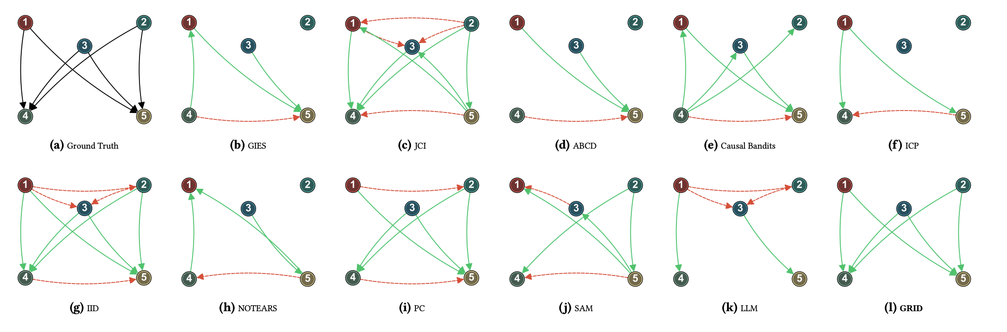

Slide 28
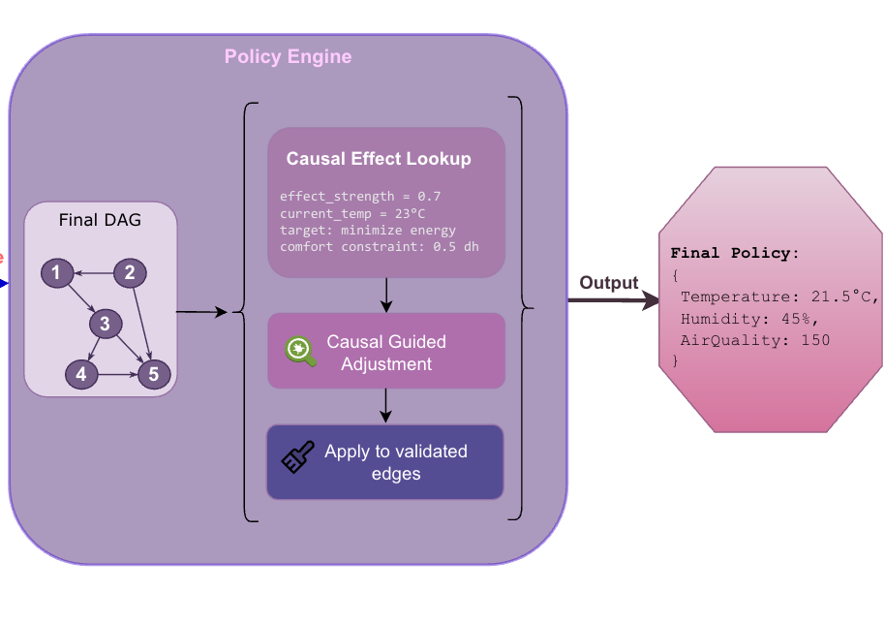
Policy Engine
Validated DAG → world model
For each edge:
Get effect_strength from past intervention data
Adjust controls accordingly
Apply necessary constraints to all adjustments
Return final policy
Notes:
Evaluate each edge vis-à-vis the objective based on intervention data from Discovery Module
Causal Optimization Step-by-Step
Initialize policy with current_state values (copy of current variable settings)
Iterate through each validated edge (source → target) in the DAG
For each edge:
Extract effect_strength = absolute value of correlation between source and target
Check what the target variable represents
If target is energy-related:
Find energy objectives in the objectives dict
Calculate reduction: 0.4 × effect_strength × objective_weight × comfort_limit
Get constraint bounds for source variable
Update: policy[source] = clip(policy[source] - reduction, min, max)
Justification:
0.4 coefficient: Aggressive but safe reduction factor (grid search)
effect_strength (0.75): Strong causal effect means more confidence in adjustment
weight (0.4): Energy is 40% of total objectives—proportional adjustment
comfort_limit (0.8): High value means we still prioritize comfort, so reduce energy savings
Subtract: Lower temperature → lower energy consumption (assuming positive correlation)
Why this works: Temperature causally drives energy use (e.g., HVAC). Lowering temp reduces consumption, scaled by how much we care about energy vs. comfort.
If target is satisfaction/comfort-related:
Find satisfaction objectives in the objectives dict
Calculate boost: 0.3 × effect_strength × objective_weight × (2.0 - comfort_limit)
Get constraint bounds for source variable
Update: policy[source] = clip(policy[source] + boost, min, max)
Justification:
0.3 coefficient: Moderate boost factor (less aggressive than energy)
effect_strength (0.65): Moderate causal effect on satisfaction
weight (0.6): Satisfaction is 60% of objectives—major priority
(2.0 - comfort_limit): Inverted comfort_limit amplifies adjustment when comfort_limit is LOW
If comfort_limit = 0.3 → (2.0 - 0.3) = 1.7 (large boost)
If comfort_limit = 0.8 → (2.0 - 0.8) = 1.2 (small boost)
Add: Higher temperature → higher satisfaction (assuming positive correlation)
Why this works: When comfort_limit is low (energy savings mode), we're willing to sacrifice satisfaction. When high (comfort mode), we boost satisfaction more aggressively.
Apply comfort-specific adjustments based on comfort_limit targets (additional fine-tuning beyond the edge-based adjustments)
Return optimized policy with adjusted variable values
The key insight: validated causal edges directly determine how much to adjust each control variable to optimize outcomes, with adjustment magnitude proportional to causal effect strength.

Slide 29
Mock Example: Causal Optimization
Step 1: Initialize (current setpoints)
policy = {'Temperature’: 23.5, 'Humidity’: 46.0}
Step 2: Edge - Temperature → EnergyConsumption
effect_strength = 0.82
reduction = 0.4 × 0.82 × 0.4 × 0.7 = 0.092
# Convert to temperature change: 0.092 × (30 - 18) = 1.1°C
policy['Temperature'] = clip(23.4 - 1.1, 18.0, 30.0) = 22.3 #°C
Step 3: Edge - Temperature → OverallSatisfaction
effect_strength = 0.68
boost = 0.3 × 0.68 × 0.6 × (2.0 - 0.7) = 0.159
# Convert to temperature change: 0.159 × 12 = 1.9°C
policy['Temperature'] = clip(22.3 + 1.9, 18.0, 30.0) = 24.2 #°C
Step 4: Edge - Humidity → OverallSatisfaction
effect_strength = 0.45
boost = 0.3 × 0.45 × 0.6 × 1.3 = 0.105
# Convert to humidity change: 0.105 × (70 - 30) = 4.2%
policy['Humidity'] = clip(46.0 + 4.2, 30.0, 70.0) = 50.2 #%
Return Optimized Policy {'Temperature’: 24.2, 'Humidity’: 50.2}
Validated DAG
Temperature → EnergyConsumption (correlation: 0.82)
Temperature → OverallSatisfaction (correlation: 0.68)
Humidity → OverallSatisfaction (correlation: 0.45)
Input Parameters
objectives = {
'energyconsumption': {'target': 20.0, 'weight': 0.4},
'overallsatisfaction': {'target': 80.0, 'weight': 0.6}
}
constraints = {
'Temperature’: (18.0, 30.0), #°C
'Humidity’: (30.0, 70.0), #%
'comfort_limit': 0.7
}
current_state = {
'Temperature’: 23.4, #°C
'Humidity’: 46.0, #%
'EnergyConsumption': 28.0, #kWh
'OverallSatisfaction': 72.0 #%
}
Notes:
Effect strength is the absolute value of the correlation (Pearson correlation) between source and target variables, extracted from the dataset and DAG
Simple & Fast: Direct measure of linear relationship strength, computed efficiently
Normalized: Always [-1, 1], making effects comparable across different variable scales
Works for validated edges: Since edges are proven causal through interventions, correlation now reflects true causal effect (not spurious) -- These edges were validated through interventions, so correlation here approximates actual causal effect size
The policy engine works in normalized [0,1] space, so:
0.092 is the normalized adjustment
(30 - 18) = 12°C is the physical temperature range
0.092 × 12 = 1.1°C is the actual temperature change
Think of 0.092 as "9.2% of the full temperature range" = 9.2% of 12°C = 1.1°C

Slide 30
Experiments
Causal Structure Recovery
tested on 6 progressively
compared against 10 representative methods
SHD, F1, precision-recall, cost/risk
Embodied Control Performance
tested in 4 embodied control scenarios
compared against 3 baselines
2 complimentary evaluation perspectives

Slide 31
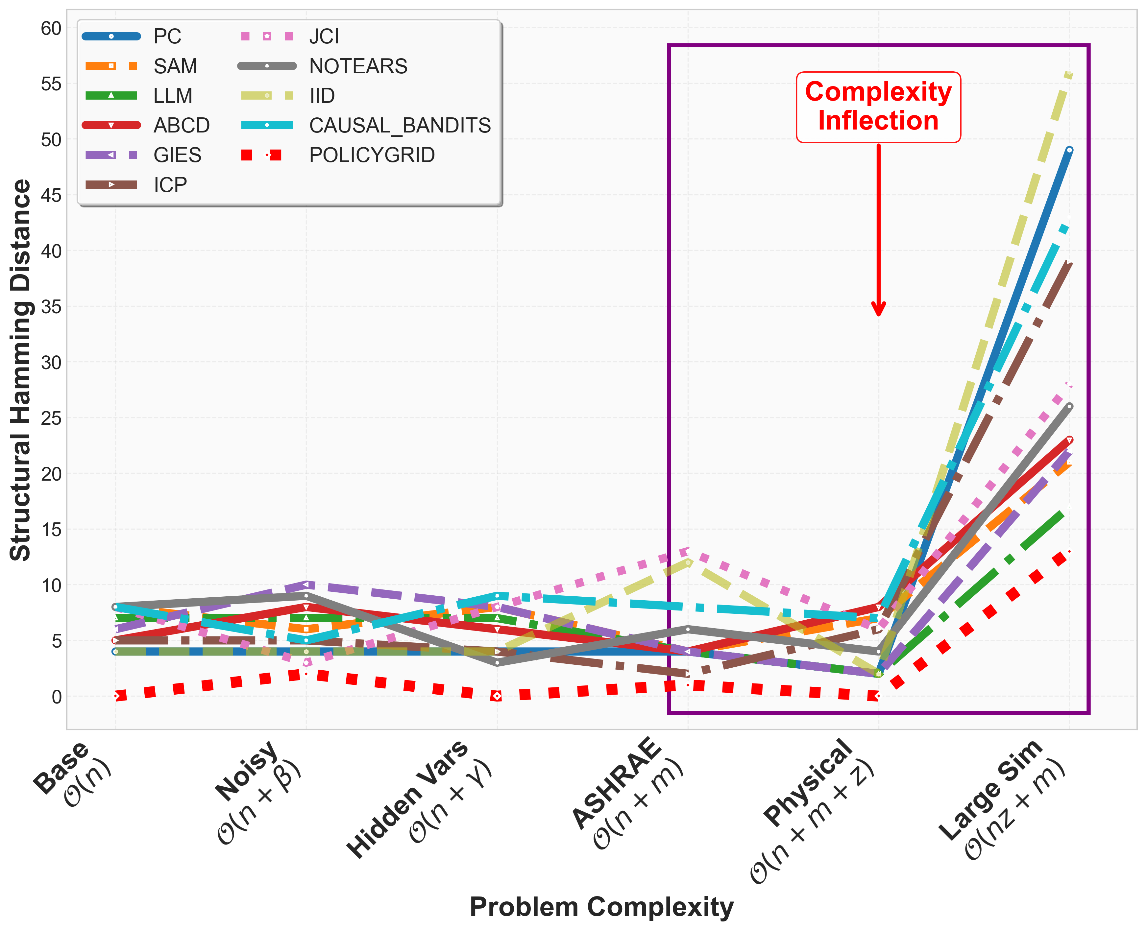
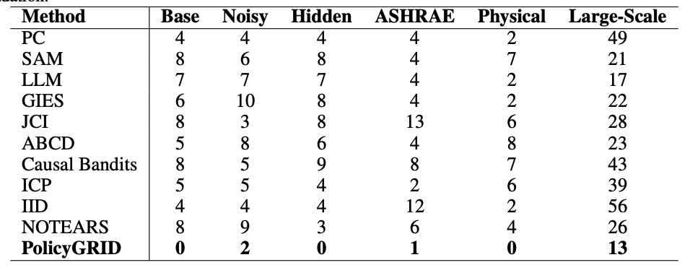
Results: Causal World Model Fidelity
PolicyGRID has lowest SHD across all setups
Baselines degrade with complexity
Notes:
Figure 2 and Table 1 report Structural Hamming Distance (SHD) between learned and ground truth graphs across six setups. POLICYGRID achieves the lowest SHD in all cases, with exact recovery in Base, Hidden-Variable, and Physical (SHD = 0), and low error in Noisy (2), ASHRAE (1), and Large-Sim (13). Baselines varied in accuracy. PC achieved relatively low SHD in simpler setups (Base: 4, Physical: 2) but degraded under complexity (Large-Sim: 49). IID and ABCD followed similar trends, reaching SHD of 56 and 53 in Large-Sim. SAM, GIES, and NOTEARS generally produced higher errors across all setups. Overall, SHD increased with setup complexity, especially beyond the Physical case, reflecting the difficulty of recovering structure in larger and noisier systems. By comparison, POLICYGRID maintained lower SHD throughout, indicating that iterative interventions and physical priors improved robustness across conditions.

Slide 32
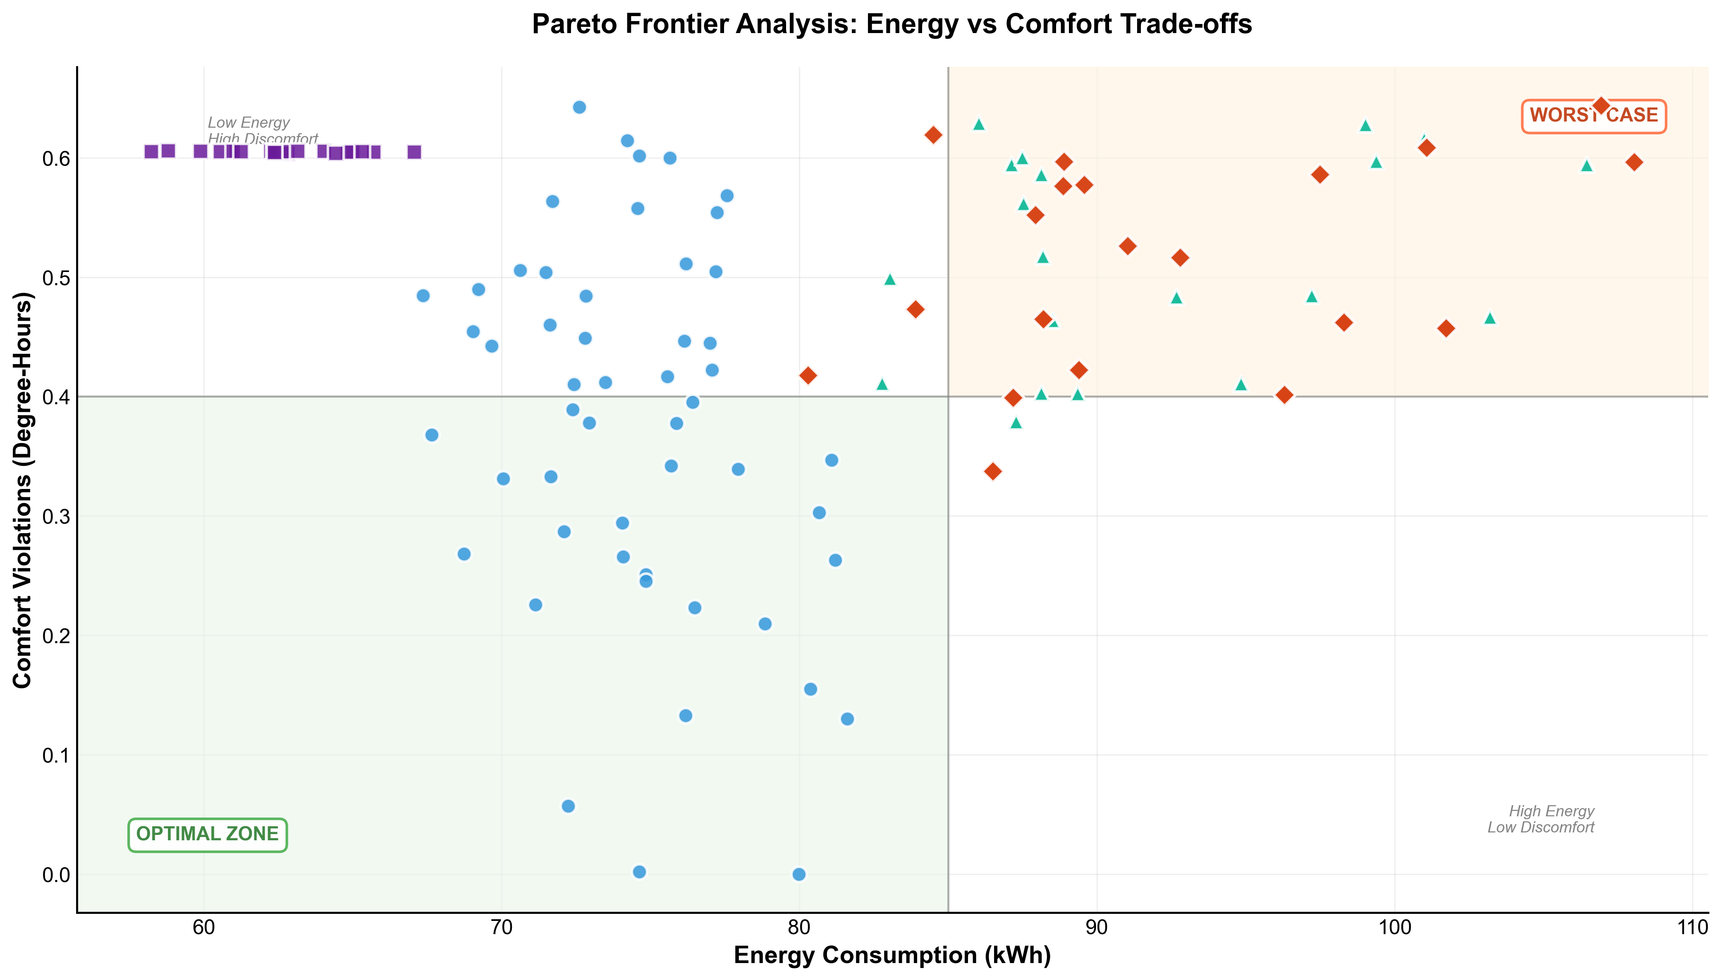
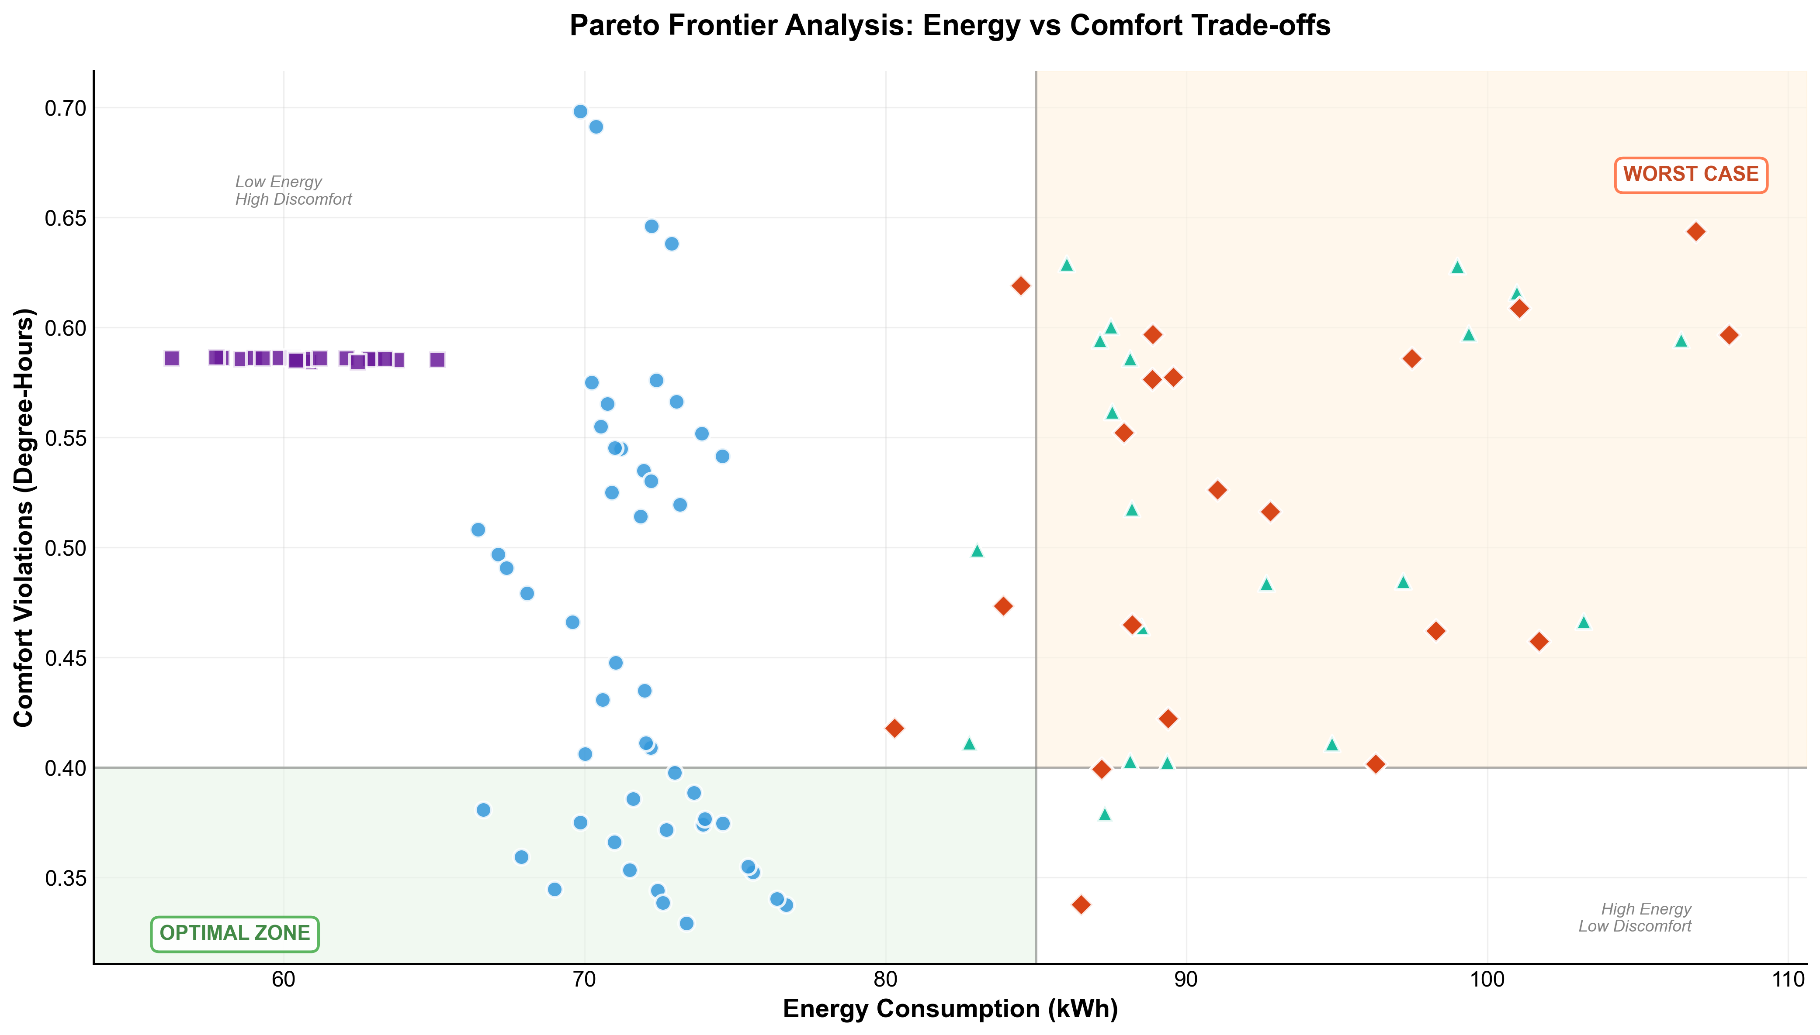
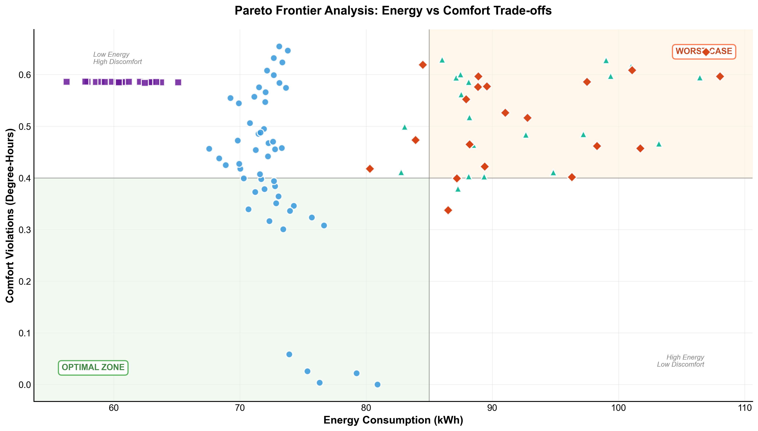
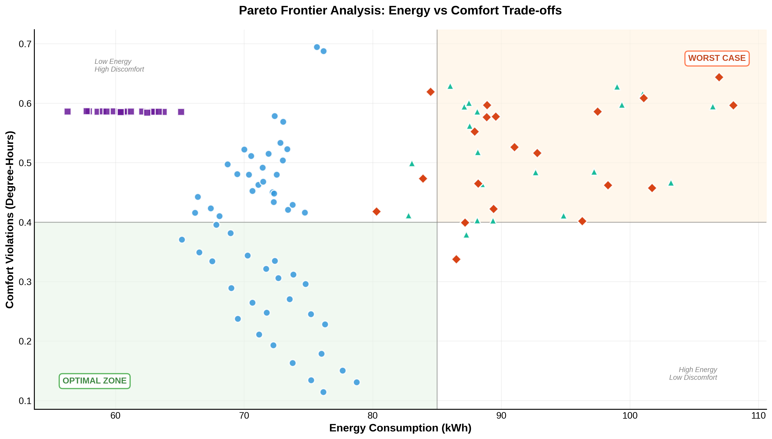
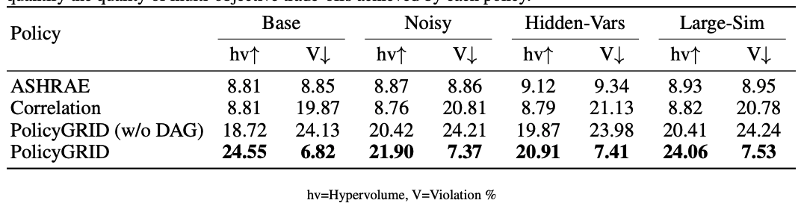
Results: Policy Performance
Highest hypervolume and lowest violation rates with PolicyGRID
Causal DAG critical for policy quality
Baselines (PID, Correlation) show low hv and high violations
PolicyGRID dominates Pareto front with low energy and low discomfort
Notes:
We evaluated four controllers: ASHRAE-PID, Correlation-based, POLICYGRID without causal
DAG, and full POLICYGRID on the Base, Noisy, Hidden-Variable, and Large-Sim setups. Table 2
reports two primary metrics: hypervolume (hv), which summarizes the area of the Pareto front over energy and comfort trade-offs (higher values indicate better trade-offs), and violation rate (V%),
defined as the percentage of time comfort bounds are exceeded (lower values are preferred).
Across all setups, POLICYGRID obtains the highest hypervolume and the lowest violation rates.
Removing the causal DAG leads to lower hypervolume and higher violation rates, showing the
importance of causal structure for policy quality. Both ASHRAE-PID and Correlation baselines
remain below 10 hv and exhibit higher violations.
Figure 3 and 4 illustrate Pareto frontier points across controllers. POLICYGRID consistently
places operating points in the low energy, low comfort violation region. Even at its least favorable
configurations, its comfort violation levels remain below those of the best baselines. ASHRAE-PID
and Correlation cluster in the high-energy, high-discomfort regime, while the DAG ablation tends to
reduce energy at the cost of high comfort violations.

Slide 33

Takeaways + Discussion
Causality links understanding and action—moving beyond pattern recognition to mechanism-based reasoning.
Structural Causal Models explain why outcomes occur and how interventions alter them.
PolicyGRID embeds this reasoning into control, yielding robust and explainable policies.
From correlation to control, it enables systems that learn to act, not just predict.
Open question: How can multimodal models better capture causal links across sensors, language, and perception?
Acting to understand — understanding to act.
https://openreview.net/pdf?id=SqaOyB89rE

